Slide 1
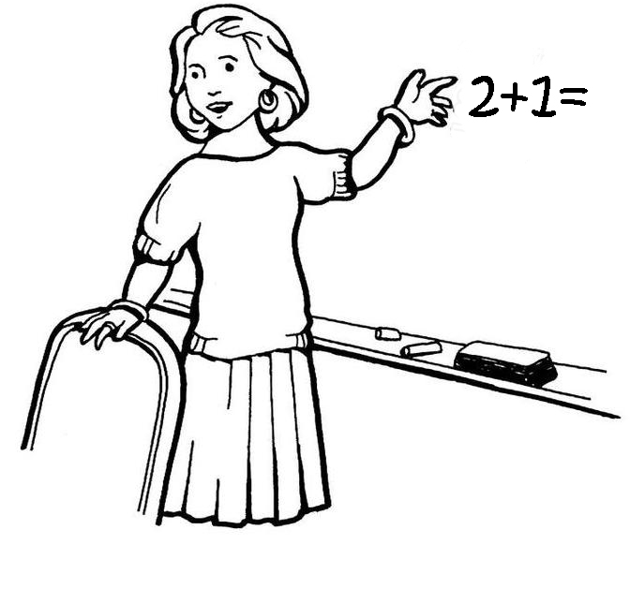
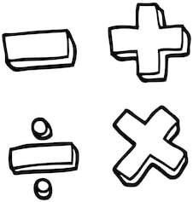
KS3 Curriculum Map
Constructions, Loci
& Bearings
Percentages
%
Reteach
Solving Equations
F
36
35
34
33
R
E
32
$$∝$$
Sequences
n
Feedback
Proportion
Year 9 Exams
Fractions, Decimals,
Percentages
Coordinates &
Graphs
$$y=mx+c$$
3D shapes
%
26
27
28
29
30
31
Powers & Roots
$$x^{−\frac{3}{2}}$$
Algebraic
Manipulation
2D Shapes
Arithmetic
Transformations
Solving Equations
Algebraic
Manipulation
$$3(x+2)$$
25
Y9
24
23
22
21
E
20
Statistics
Angles
Year 8 Exams
Working with Data
“The Gambia Project”
Rounding &
Estimation
3D Shapes
Calculations with
Fractions
Y8
13
14
15
16
17
18
19
12
Positive &
Negative Numbers
$$±$$
Length & Area
Compound measures
m/s
Probability
Coordinates
& Graphs
Year 7 Exams
2D Shapes
& Angles
Converting FDP
$$y=mx+c$$
%
11
10
R
E
9
8
7
6
Ratio &
Proportion
:
Reteach
Intro to Algebra
Perimeter & Area
$$x$$
Open evening
Transition day
The Four Operations
Order of Operations
Y5
Y6
Y7
5
Y9
E
OE
S
OE
En
T
1
2
B
3
4
SATs
Place Value
Baseline
Assessment
$${}^{3}$$
Fractions
Types of Number
ALNS Mathematics Department

